Slide 1
Data Structures
Overview
In this lesson, students will learn how to use lists and dictionaries to organize data.
Duration 120 minutes
Learning Objectives
In this lesson, students will:
Use lists and list methods to manage collections of data.
Use index-based retrieval to access and manipulate list items.
Use dictionaries to represent data with multiple properties.

Slide 2
Pre-Class Materials and Preparation
For remote classrooms: Virtual breakout rooms and Slack may be needed to facilitate the partner exercise and discussions. As you plan for your lesson:
Consider how you’ll create pairs for the partner exercise (randomly, or with pre-assigned partners).
Determine how (if at all) exercise timing may need to be adjusted.
For helpful tips, keep an eye out for the For remote classrooms tag in the speaker notes.
Prepare screenshots and answers to exercises in advance so that they can be easily shared in Slack during your lecture.

Slide 3
Pre-Class Materials and Preparation (Cont.)
Pre-Work Review: Many of the concepts covered in this class will recap what students learned in the pre-work; in particular, these myGA lessons:
Manipulating Variables in Python
Data Types in Python
We recommend reviewing the pre-work lessons to understand what students will come to class knowing. Click here to see the study guides for these lessons. You can also view the pre-work materials on myGA.
For review or extension topics, review the notes in the pre-work for recommendations on how to teach the concept. Leverage the discussions, exercises, and knowledge checks to gauge students’ understanding of concepts. You can adjust your approach to the lesson overall based on how students do with these exercises.

Slide 4
Suggested Agenda
Time | Activity
0:00–0:15 | Welcome + Introduction to Data Structures
0:15–0:55 | Lists and Tuples
0:55–1:05 | Break
1:05-1:30 | Dictionaries
1:30–1:50 | Combining Data Structures
1:50–2:00 | Wrapping Up, Q&A, and Exit Ticket Completion

Slide 5
Jupyter Notebook
The exercises referenced in this lesson can be found in the Python Workbooks + Data folder.
Our first few lessons begin by reviewing the notebook, as the same material was covered in the pre-work.
If students feel that they are able to confidently solve the challenges in the workbook, you can quickly skim through the lesson content and have them only complete the challenges.

Slide 6
Data Structures
Notes:
Duration: 15 minutes

Slide 7
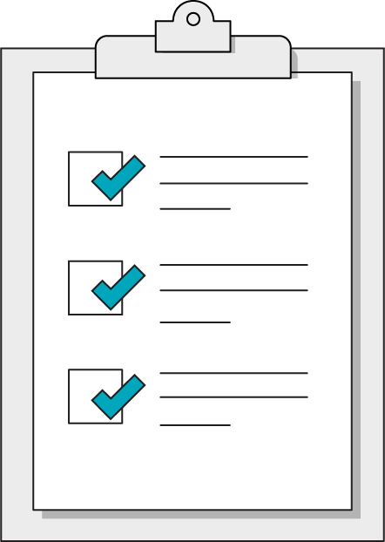
Our Learning Goals
Use lists and list methods to manage collections of data.
Use index-based retrieval to access and manipulate list items.
Use dictionaries to represent data with multiple properties.
Notes:
Purpose: Set expectations for the lesson.
For remote classrooms:
Capture a screenshot of this slide and drop it in the class Slack channel.

Slide 8
What We’ll Practice Today
This class is a blended learning experience. It connects to and reinforces topics that you encountered in the myGA pre-work.
We’re going to return to topics covered in the pre-work and build upon them:
Data structures like lists, tuples, and dictionaries.
Combining data structures.
List methods.
Notes:
Purpose: Connect the rest of class to what we’ve already learned in the pre-work.
TALKING POINTS:
We know that you encountered some of what’s in today’s lesson in the pre-work. That’s intentional! We use a blended learning approach that incorporates myGA, assessments, and in-class lessons. They all work together to help you succeed in the course and let us know where you’re coming from.
We don’t want to bore you with stuff you already know, but we also don’t want to skip over really crucial topics. We’ll use discussions and exercises to make sure we’re going at your speed when it comes to familiar topics, as well as the new ones.
The pre-work helps you come into the classroom with a solid, foundational understanding of the basics. We’re going to practice and reinforce those topics and then start to build upon them.

Slide 9
Jupyter Notebook Review
10 minutes
Let’s dive right in and use what we learned in the pre-work! We want to understand where you are in your learning journey so that we can give the best possible experience in class.
Look over the exercises in today's Jupyter Notebook and attempt any that seem immediately doable to you.
Then, rate your confidence level on today's subjects from 1–5.
Notes:
Purpose: Understand how much students have retained from the pre-work lessons.
TEACHING TIPS:
This exercise will help you gauge where students are in terms of how much they retained from the pre-work so that you can appropriately adjust the rest of the lesson/future lessons.
Remind students that we're not asking them to complete all questions immediately. Note that, if they are struggling, we’ll recap how to write each of them in this and the following lesson.
For remote classrooms:
Ask students to rate their confidence in this subject using Slack response emojis 1–5, or a quick anonymous poll. If ALL students feel confident in this subject, feel free to skip through the actual lesson slides and dive right into the exercises in the notebook.

Slide 10

Our Sad, Unstructured Data
So far, our variables have only stored a single piece of information, or data. Imagine trying to represent a data set using this method:
customer_one = "Anees Rosario"
customer_two = "Alya Pham"
customer_three = "Marc Wormald"
customer_four = "Ellie-Mai Muir"
You won’t get very far using a new variable for every new piece of data!
Notes:
Purpose: Frame the importance of data structures.
TEACHING TIPS:
Note also how “hard-coded” this list would be — you would have to remember exactly which variable contained each string!
And what happens when we want to get rid of “customer_three” and move everyone else up by one?

Slide 11
Data Structures to the Rescue!
Fortunately, Python provides us with some options for compiling data into a single structure:
Lists are exactly what they sound like: comma-separated lists of values.
Tuples are like lists but more strict. You can’t update the values in a tuple!
Dictionaries allow us to associate multiple properties together, much like a single row of a spreadsheet can contain many columns.
Notes:
Purpose: Define the three data structures we’ll cover in class.
TEACHING TIPS:
This should be a review of what students saw in the pre-work.

Slide 12
Guess the Data Structure!
Before we get into the specifics, let’s think about which of our three data structures (lists, tuples, and dictionaries) makes the most sense when representing the following information:
The five continents on Earth.
An item for sale in our store.
All transactions conducted in our store.
A single transaction conducted in our store.
A weather forecast for today.
The three possible quality rankings for produce.
Notes:
Purpose: Get students to consider how best to use each data structure.

Slide 13
Data Structures Revealed
Tuples hold values that will not change, while lists can be updated more easily. Dictionaries represent a single, but complex, piece of information.
The five continents on Earth: Tuple.
An item for sale in our store: Dictionary.
All transactions conducted in our store: List.
A single transaction conducted in our store: Dictionary.
A weather forecast for today: Dictionary.
The three possible quality rankings for produce: Tuple.
Notes:
Purpose: Get students to consider how best to use each data structure.
TALKING POINTS:
The common theme here is that tuples hold values that will not change over time.
You might have to update a transaction, but reference data such as continents or quality ranks won’t change.
Dictionaries represent a single, but complex piece, of information with multiple properties.

Slide 14
Lists and Tuples
Data Structures
Notes:
Duration: 40 minutes

Slide 15
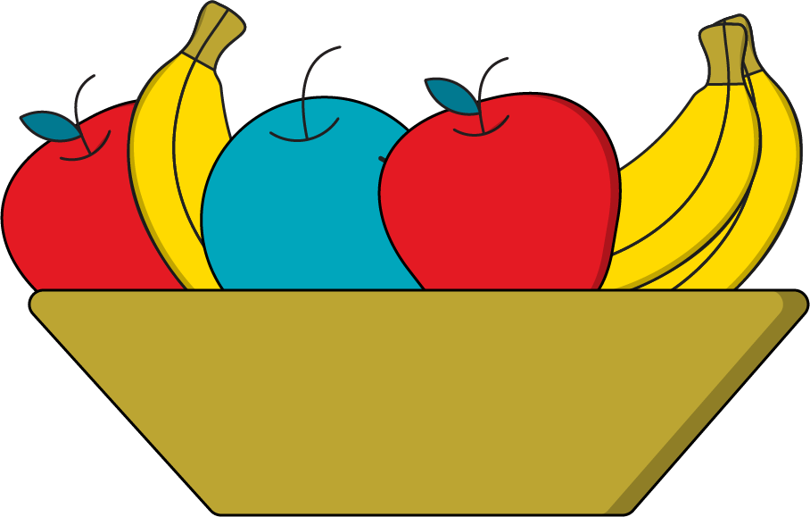
Lists
A list is an ordered collection of data combined into one variable.
Each item in an list is assigned an index value based on its position. These index values allow us to access individual elements within the list.
["banana", "orange", "apple"]
0
1
2
Notes:
Purpose: Review lists.
TEACHING TIPS:
This should be a review of what students saw in the pre-work.

Slide 16
Syntax
fruits = ["banana", "orange", "apple"]
You create a list using a set of square brackets.
Inside the brackets, each value must be separated by a comma.
Although it most often makes sense for all values to be the same data type, there’s no rule against using a list to store data of varying types.
Notes:
Purpose: Review list syntax.
TEACHING TIPS:
This should be a review of what students saw in the pre-work.

Slide 17
Accessing List Values
fruits = ["banana", "orange", "apple"]
# fruits[0] will access "banana"
# fruits[1] will access "orange"
# fruits[2] will access "apple"
Access list items using square brackets around their index values. It’s pretty simple — just remember that the first index value is always zero!
Notes:
Purpose: Review accessing lists.
TEACHING TIPS:
This should be a review of what students saw in the pre-work.

Slide 18
Updating List Values
fruits = ["banana", "orange", "apple"]
fruits[0] = "kiwi"
fruits[1] = "strawberry"
# The fruits list now looks like ["kiwi", "strawberry", "apple"]
We can update the items in a list using the same index syntax. The same assignment operator that we used with individual variables can also be used to set the value of a specific item in a list.
Notes:
Purpose: Review updating lists.
TEACHING TIPS:
This should be a review of what students saw in the pre-work.

Slide 19
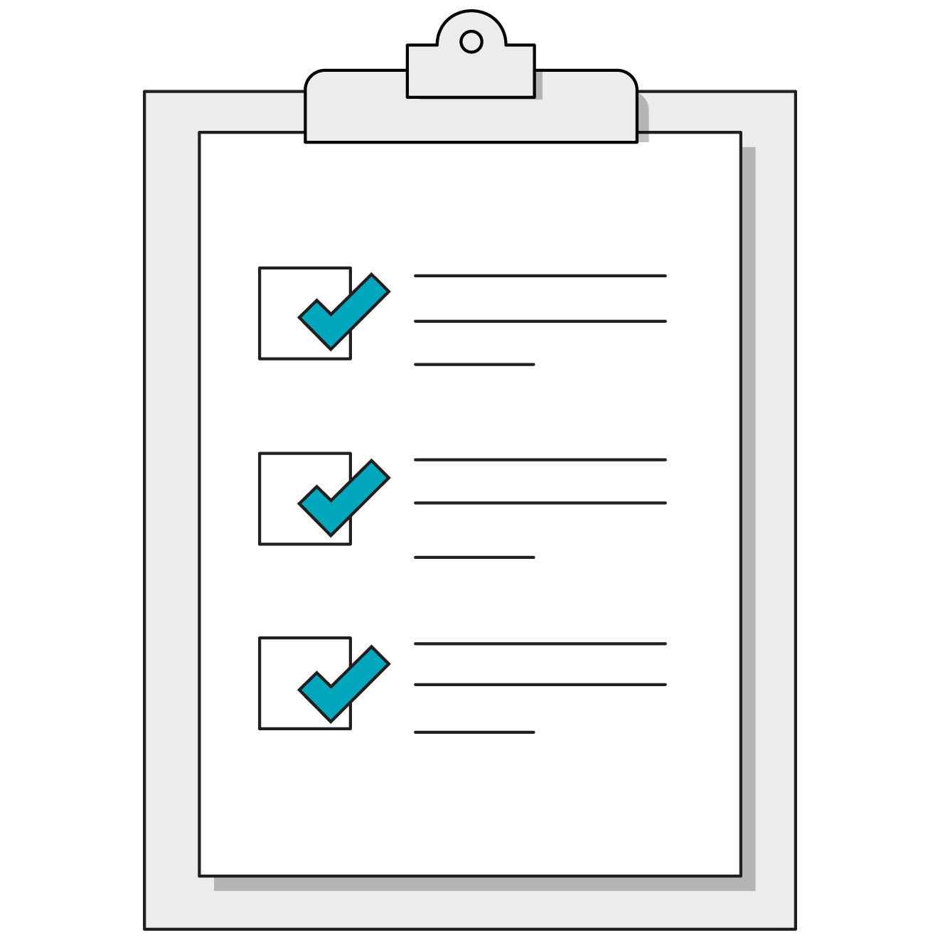
2.1 Colors of the Rainbow
15 minutes
Let’s practice creating a list, along with accessing and updating values using the specific list index syntax.
Notes:
Purpose: Review accessing and updating lists.
TEACHING TIPS:
This should be a review of what students saw in the pre-work.

Slide 20
List Methods
In addition to using index syntax to refer to specific items, we can also use methods of lists to perform specific actions on that list. The syntax looks like:
list_name.method_name( any_inputs_here )
The parentheses might remind you of the print statements we’ve used thus far. That’s because, just like print(), methods can also accept specific input, or arguments, for their operations.
Notes:
Purpose: Review list methods.
TEACHING TIPS:
This should be a review of what students saw in the pre-work.

Slide 21
Adding Items With .append()
fruits = ["orange"]
fruits.append("kiwi")
# fruits is now: ["orange", "kiwi"]
The .append() method adds the item inside the parentheses to the end of the list.
Notes:
Purpose: Introduce .append().

Slide 22
Adding Items With .insert()
fruits = ["orange", "kiwi"]
fruits.insert(1, "lemon")
# fruits is now: ["orange", "lemon", "kiwi"]
The .insert() method starts by taking an index number, then adds the second argument in the parentheses to the given index.
Note the original item at that index is simply bumped to the next spot in the list.
Notes:
Purpose: Introduce .insert().

Slide 23
Removing Items With .pop()
fruits = ["orange", "kiwi", "lime"]
fruits.pop()
# fruits is now: ["orange", "kiwi"]
fruits.pop(0)
# fruits is now: ["kiwi"]
The .pop() method can be used to remove the item at a specific index, or, if you don’t provide any index, it will simply remove the last item in the list.
Notes:
Purpose: Introduce .pop().

Slide 24

2.2 The Wait List
20 minutes
Let’s practice these list methods and more by managing the waiting list for the Python Academy, the most exclusive private boarding school in all of East Python-shire.
Notes:
Purpose: Give students time to practice using list methods.

Slide 25
More List Functions
 | Explanation | Example
len() | Produces the length of the list. | fruits = ["apples", "bananas", "oranges"] len(fruits) # 3
min() and max() | Produces the minimum or maximum. | scores = [10, 20, 30] min(scores) # 10 max(scores) # 30
sum() | Produces the total sum of all items in the list. | sales = [25, 15, 10] sum(sales) # 50
Notes:
Purpose: Introduce additional list functions.
TEACHING TIPS:
This is simply to show that not all functions involving lists have to be methods of the list itself.
Some of these aggregate functions will be very important for the purposes of analysis, and no discussion of lists is complete without introducing len().

Slide 26
Tuples: You Already Know Them!
The good news about tuples is that they work exactly the same way as lists, but simply use parentheses instead of square brackets.
valid_statuses = ("operational", "faulty", "non-operational")
The difference is that tuple values are immutable, meaning you cannot change values in a tuple once it’s been created; thus, tuples are mostly used for reference information that will not change.
Notes:
Purpose: Review tuples.
TEACHING TIPS:
This should be a review of what students saw in the pre-work.
Students won't need to use tuples very often, but they should know that tuples have separate methods than lists.
Most of the time they'll just need to access values in a tuple, but anything more complex is typically just a method to look up.
You might even want to demonstrate how quickly their questions about “how to do ____” in a tuple can be answered by taking a examples and googling them.

Slide 27
Sets
A set is an unordered collection of unique values. You can’t use an index to access a specific element in a set. Instead, sets have methods for accessing or manipulating collection members:
primary_colors = { "red", "blue", "yellow" }
primary_colors.add("green")
primary_colors.remove("yellow")
Notes:
Purpose: Introduce sets.

Slide 28
Dictionaries
Data Structures
Notes:
Duration: 25 minutes

Slide 29
Dictionary Definition
A dictionary is a collection of associated keys and values. Think of a dictionary like a row of data in a spreadsheet — you have column names, which are your keys, and then you have the actual values inside of the columns.
item_name | category | price
tomatoes | food | 1.99
# The above row would be translated into this dictionary
{ "item_name": "tomatoes", "category": "food", "price": 1.99 }
Notes:
Purpose: Review dictionaries.
TEACHING TIPS:
This should be a review of what students saw in the pre-work.
You could also ask students to translate a given row of data into a dictionary if the syntax is giving them difficulty.

Slide 30
Syntax for Dictionaries (Cont.)
item = { "item_name": "tomatoes", "category": "food", "price": 1.99 }
Curly braces are used to start and end the dictionary.
Notes:
Purpose: Review dictionary syntax.
TEACHING TIPS:
This should be a review of what students saw in the pre-work.

Slide 31
Syntax for Dictionaries (Cont.)
item = { "item_name": "tomatoes", "category": "food", "price": 1.99 }
Key names are provided first and surrounded by quotation marks.
Notes:
Purpose: Review dictionary syntax.
TEACHING TIPS:
This should be a review of what students saw in the pre-work.

Slide 32
Syntax for Dictionaries (Cont.)
item = { "item_name": "tomatoes", "category": "food", "price": 1.99 }
Values are provided after a colon and can be of any data type.
Notes:
Purpose: Review dictionary syntax.
TEACHING TIPS:
This should be a review of what students saw in the pre-work.

Slide 33
Syntax for Dictionaries (Cont.)
item = { "item_name": "tomatoes", "category": "food", "price": 1.99 }
Finally, note the commas separating each key-value pair.
Notes:
Purpose: Review dictionary syntax.
TEACHING TIPS:
This should be a review of what students saw in the pre-work.

Slide 34
Accessing Values in a Dictionary
item = { "item_name": "tomatoes", "category": "food", "price": 1.99 }
Accessing specific values in a dictionary works a lot like accessing specific items in a list. This time, instead of numbered indices, we use the name of the key.
item["category"]
# This accesses the value "food"
Notes:
Purpose: Review accessing dictionaries.
TEACHING TIPS:
This should be a review of what students saw in the pre-work.

Slide 35
Adding Values to a Dictionary
One of the most powerful features of a dictionary is the ability to add new keys and values whenever necessary.
item["fresh"] = True
item["discount"] = .15
The same syntax can update a given property as well.
item["fresh"] = False
Notes:
Purpose: Review adding data to a dictionary.
TEACHING TIPS:
This should be a review of what students saw in the pre-work.

Slide 36

2.3 Key Value Properties
15 minutes
Practice accessing and updating properties in a dictionary by modifying a real estate listing in Section 2.3 of the Jupyter Notebook.
Notes:
Purpose: Review accessing and updating dictionaries.
TEACHING TIPS:
This should be a review of what students saw in the pre-work.

Slide 37
Representing a Data Set
Based on what we know about data structures, how would we represent an entire data set (like a .csv file), with many rows and columns of information, in Python?
item_name | category | price
tomatoes | food | 1.99
mango | food | 3.00
journal | office | 15.00
Notes:
Purpose: Connect data structures to working with data and data analytics.

Slide 38
Representing a Data Set
Answer: A list of dictionaries! Each dictionary is a specific row, and the list is our “table” collecting all of the rows together.
[ {"item_name" : "tomatoes", "category": "food", "price" : 1.99},
{"item_name" : "mango", "category": "food", "price" : 3.00},
{"item_name" : "journal", "category": "office", "price" : 15.00} ]
Notes:
Purpose: Connect data structures to working with data and data analytics.
TEACHING TIPS:
Hopefully this connection to data formats the students are already familiar with helps solidify the role of lists and dictionaries in data analysis.
Dictionaries can be tricky to understand, so the comparison to rows and columns can help familiarize the concept.

Slide 39
Combining Data Structures
Data Structures
Notes:
Duration: 25 minutes

Slide 40
Nested Data Structures
So far, we’ve seen lists and dictionaries that organize simpler data types, like strings and numbers. However, it’s common to see the more complex data structures nested within each other, creating elaborate mazes of data.
When getting data from outside sources, for example, you might be given a dictionary that contains another dictionary that contains a list containing another dictionary that finally contains the information you’re looking for!
Notes:
Purpose: Introduce nested data structures.
TALKING POINTS:
Nested data structures can make programming complicated, but they are also what makes it more powerful than other analysis tools like Excel.
You can’t have a cell that’s actually an entire table, but you can have a dictionary that contains another list of dictionaries, and so on.
This ability to build in powerful, complex relationships between data is a compelling benefit of Python over more user-friendly data analysis tools.

Slide 41
What Is This Accessing?
Think about what the following line of code is saying, one layer at a time:
authors[0]["books"][1]["title"]
Without seeing the exact data structure in question, what is this line attempting to access?
Notes:
Purpose: Get students to think through accessing more complex data structures.

Slide 42
Peeling Back the Layers
authors[0]
# There is a list called authors and we want the first thing in it.
Notes:
Purpose: Get students to think through accessing more complex data structures.

Slide 43
Peeling Back the Layers
authors[0]["books"]
# There is a list called authors and we want the first thing in it.
# That first thing is a dictionary and we want the "books" property.
Notes:
Purpose: Get students to think through accessing more complex data structures.

Slide 44
Peeling Back the Layers
authors[0]["books"][1]
# There is a list called authors and we want the first thing in it.
# That first thing is a dictionary and we want the "books" property.
# Turns out "books" is a list and we want the second thing in it.
Notes:
Purpose: Get students to think through accessing more complex data structures.

Slide 45
Peeling Back the Layers
authors[0]["books"][1]["title"]
# There is a list called authors and we want the first thing in it.
# That first thing is a dictionary and we want the "books" property.
# Turns out "books" is a list and we want the second thing in it.
# That second thing is another dictionary with a "title" property.
Notes:
Purpose: Get students to think through accessing more complex data structures.

Slide 46
Keep Calm and print() On
When dealing with a complex, multi-level data structure, you can lean on print statements to help peel back the layers one at a time. The syntax for accessing elements doesn’t change, you just simply need more layers:
print(authors[0])
print(authors[0]["books"])
print(authors[0]["books"][1])
print(authors[0]["books"][1]["title"])
Notes:
Purpose: Get students to think through accessing more complex data structures.
TEACHING TIPS:
You can demonstrate this process using the notebook challenge’s complex data structure to illustrate the point.
You can also add more properties/nested structures to repeat the technique.

Slide 47

2.4 Python Librarian
15 minutes
Managing nested data structures can be difficult!
Work through the challenges of accessing and modifying the “authors” dictionary found in Section 2.4 of the workbook.
Notes:
Purpose: Give students time to practice accessing complex dictionaries.
TEACHING TIPS:
If students aren’t able to finish this exercise in class, encourage them to complete it as homework.

Slide 48
Wrapping Up
Data Structures
Notes:
Duration: 10 minutes

Slide 49
Recap
Looking Ahead
In today’s class, we…
Used lists and list methods to manage collections of data.
Used index-based retrieval to access and manipulate list items.
Used dictionaries to represent data with multiple properties.
On your own:
Ensure that you’ve completed the Python pre-work and pre-work quiz.
Next Class:
Conditionals
Notes:
Purpose: Recap what was covered in the lesson.

Slide 50

Don’t Forget: Exit Tickets!

